Slide 1

CAP 6317/4773: Social Media Mining
Lecture 11: Data Mining
Raiyan Abdul Baten, Ph.D.
February 13, 2024

Slide 2
Recap

Slide 3


Which bar plot is more trustworthy? Why?
Two teams study the same watch on a separate set of participants. Whiskers denote 95% C.I.
Larger n => Narrower margin of error => Narrower C.I.
Narrower C.I. => We have a better sense of the ‘true’ population mean
Sleep Tracking Accuracy
Confidence interval = sample mean ±

Slide 4
Insignificant differences between two groups…

Slide 5

…can become significant with more data.
But not the other way around (assuming the data is collected correctly).

Slide 6
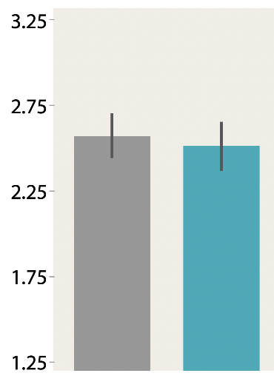
The 95% C.I. bars are overlapping. So, the true population means of the two groups might be the same. The statistical tests will confirm that the two groups are not ‘significantly’ different

Slide 7
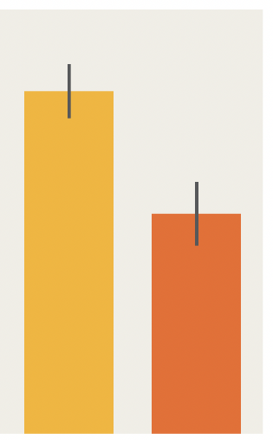
The 95% C.I. bars are not overlapping. So, based on visual eyeballing of the plots, we can hope that the differences between the two groups are significant. We need to run the correct statistical test to confirm it.

Slide 8
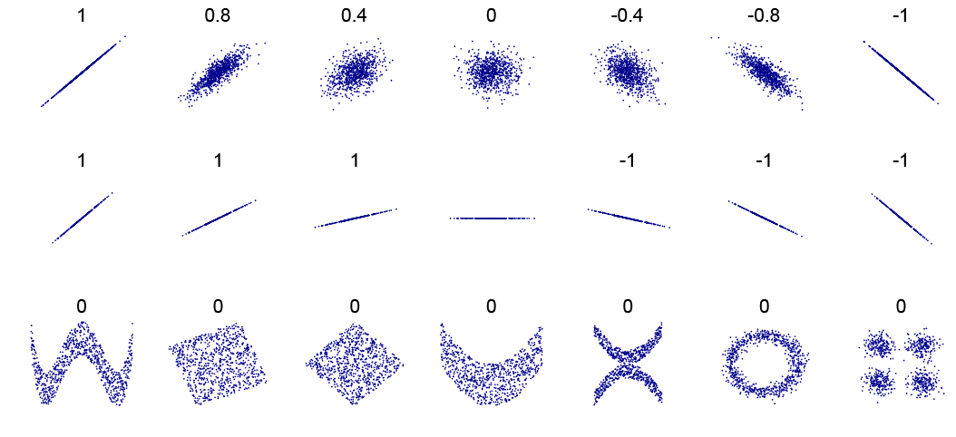
By DenisBoigelot, original uploader was Imagecreator - Own work, original uploader was Imagecreator, CC0, https://commons.wikimedia.org/w/index.php?curid=15165296

Slide 9
Pearson’s r
Spearman’s ρ
Kendall’s τ
If x increases, does y increase linearly?
Expects a straight line for perfect correlation. For a curve like y=x², the pearson correlation will not be 1.

Slide 10
Pearson’s r
Spearman’s ρ
Kendall’s τ
If x increases, does y increase?
Doesn’t care how much y increases. It suffices to increase.

Slide 11
Pearson’s r
Spearman’s ρ
Kendall’s τ
Similar to Spearman but more robust to outliers

Slide 12
Toss a coin to your Witcher
This can happen due to chance
 | Heads | Tails | Total
Observed frequencies | 4 | 6 | 10
 | Heads | Tails | Total
Observed frequencies | 400 | 600 | 1000
This seems pretty systematic

Slide 13
Office absence patterns seem a bit … odd?
 | Monday | Tuesday | Wednesday | Thursday | Friday | Total
Number of absences | 15 | 12 | 9 | 9 | 15 | 60
Intuition
Chi Square test examines if the observed frequencies are systematically different than our expected frequencies

Slide 14
Chi-Squared test to the rescue!
 | Monday | Tuesday | Wednesday | Thursday | Friday | Total
Number of absences | 15 | 12 | 9 | 9 | 15 | 60
Null hypothesis, H₀: The observed frequencies do not deviate from the expected frequencies
The coin is unbiased / the employees’ absences can be explained by random fluctuations around the expected frequencies
Alternative hypothesis, H_{a}: The data systematically deviates from the expected frequencies–not random!
The coin is biased / the employees’ absences in different weekdays are systematic

Slide 15
Chi-Squared test: Step 2
Calculate the test statistic
 | Monday | Tuesday | Wednesday | Thursday | Friday | Total
Number of absences | 15 | 12 | 9 | 9 | 15 | 60
Expected absences | 12 | 12 | 12 | 12 | 12 | 60

Slide 16
Chi-Squared test: Step 3
Compare the test statistic against the chart
We need to know the degree of freedom: df = n-1
There are n=5 columns/workdays. But we know the total number of absences. So (any) 4 of the workdays are truly free to assume any value, but the last workday needs to make sure that all 5 sum up to the total (i.e., we can calculate the 5th day’s absence from the 4 days’ absence data and the total). In other words, n-1 of those days are truly ‘free’, the last one is not. Therefore, df = 5-1 = 4
We need to decide on a significance level: typically α = 0.05 for 95% confidence.

Slide 17
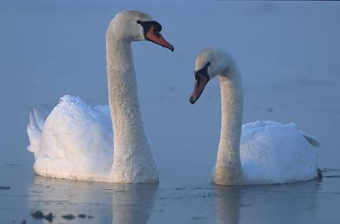
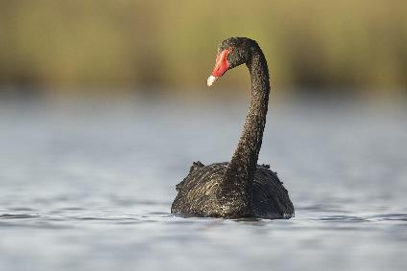
Hypothesis Testing: Intuitions
Potential hypothesis: All swans are white.
Yikes.
A single future observation of a black swan (e.g., in Australasia) can disprove that hypothesis
(left) By Marek Szczepanek - Own work, CC BY-SA 3.0, https://commons.wikimedia.org/w/index.php?curid=81312. (right) By Marek Szczepanek - Own work, CC BY-SA 3.0, https://commons.wikimedia.org/w/index.php?curid=81312

Slide 18
Skeptical Thinking: The wisdom of Scooby Doo
Hypothesis 1: There are no ghosts
Hypothesis 2: There are ghosts

Slide 19
Skeptical Thinking: The wisdom of Scooby Doo
Hypothesis 1: There are no ghosts
Hypothesis 2: There are ghosts
If we start with this belief, we might keep looking for evidence that supports this belief (similar to finding more white swans), or interpret ambiguous data in favor of ghosts, or ignore contradictory evidence

Slide 20
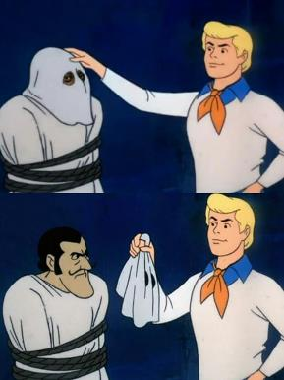
Skeptical Thinking: The wisdom of Scooby Doo
Hypothesis 1: There are no ghosts
Hypothesis 2: There are ghosts
If instead we start with a skeptical belief that no ghost exists, we can wait for strong evidence before we reject this skeptical belief.
Extraordinary claims require extraordinary evidence!

Slide 21
The Method of Contradiction
Claim: There is life on other planets.
Notes:
Example credit: Research By Design, Youtube content. https://www.youtube.com/watch?v=yLzYy_Rs8C4&ab_channel=ResearchByDesign

Slide 22
The Method of Contradiction
Claim: There is life on other planets.
Can you prove it true?
Can you prove it false?

Slide 23
The Method of Contradiction
Claim: There is life on other planets.
Can you prove it true?
Yes.
Can you prove it false?
We can prove the claim true when we observe a planet that has life

Slide 24
The Method of Contradiction
Claim: There is life on other planets.
Can you prove it true?
Yes.
Can you prove it false?
No.
We can NEVER prove the claim false. We might observe millions of planets that don’t have life (just like finding lots of white swans), sure. But the moment we declare the claim false, someone can find life on the next planet and prove us wrong.

Slide 25
The Method of Contradiction
Claim: There is life on other planets.
Can you prove it true?
Yes.
Can you prove it false?
No.
Claim: There is not life on other planets.
Can you prove it true?
Can you prove it false?
Let us flip the table so that we start with a skeptical belief

Slide 26
The Method of Contradiction
Claim: There is life on other planets.
Can you prove it true?
Yes.
Can you prove it false?
No.
Claim: There is not life on other planets.
Can you prove it true?
Evidence supports
Can you prove it false?
We will still not ‘accept’ this skeptical belief straight away. We will just say “we don’t know” or “things are inconclusive” even when more and more planets keep emerging with no life

Slide 27
The Method of Contradiction
Claim: There is life on other planets.
Can you prove it true?
Yes.
Can you prove it false?
No.
Claim: There is not life on other planets.
Can you prove it true?
Evidence supports
Can you prove it false?
Yes.
The moment we observe a planet with life, we’ll happily “reject” our skeptical position and make a discovery. The key difference between the two claims is that the bottom claim is ‘falsifiable’. And once the claim is proven to be false, we make a discovery.

Slide 28
The Method of Contradiction
Claim: There is life on other planets.
Can you prove it true?
Yes.
Can you prove it false?
No.
Claim: There is not life on other planets.
Can you prove it true?
Evidence supports
Can you prove it false?
Yes.
“Falsifiable”: The Method of Contradiction offers up a statement that can be definitively proven false, and then we use our statistics techniques to attempt to do so. The fact is that statistics can never prove a hypothesis true, but we can sometimes prove one false. Only a falsifiable hypothesis can teach us something definitive.

Slide 29
Reminder to self: Attendance

Slide 30
Hypothesis Testing

Slide 31
Does the choice of UI (Light vs Dark mode) affect usage duration?
Skeptical (Null) hypothesis: There is no difference in usage duration
Alternative hypothesis: There is a difference in usage duration

Slide 32
Does the choice of UI (Light vs Dark mode) affect usage duration?
Skeptical (Null) hypothesis: There is no difference in usage duration
Alternative hypothesis: There is a difference in usage duration
H₀: µ_{D} = µ_{L}
H_{a}: µ_{D} ≠ µ_{L}
µ_{D} and µ_{L} are the mean usage durations of the dark and light mode interfaces

Slide 33
Does the choice of UI (Light vs Dark mode) affect usage duration?
Skeptical (Null) hypothesis: There is no difference in usage duration
Alternative hypothesis: There is a difference in usage duration
H₀ is the standard notation to denote the “Null hypothesis”. This is our default or skeptical position. It has to “falsifiable”.
Formally, a Null Hypothesis is a statement that in the general population, no difference exists between samples on a variable
H₀: µ_{D} = µ_{L}
H_{a}: µ_{D} ≠ µ_{L}
µ_{D} and µ_{L} are the mean usage durations of the dark and light mode interfaces

Slide 34
Does the choice of UI (Light vs Dark mode) affect usage duration?
Skeptical (Null) hypothesis: There is no difference in usage duration
Alternative hypothesis: There is a difference in usage duration
There is no difference in usage duration (according to the null hypothesis), so the usage durations are the same. This is our skeptical position. We need evidence to trust otherwise.
H₀: µ_{D} = µ_{L}
H_{a}: µ_{D} ≠ µ_{L}
µ_{D} and µ_{L} are the mean usage durations of the dark and light mode interfaces

Slide 35
Does the choice of UI (Light vs Dark mode) affect usage duration?
Skeptical (Null) hypothesis: There is no difference in usage duration
Alternative hypothesis: There is a difference in usage duration
H_{a} is the alternative hypothesis. This is the conclusion we make when there is strong evidence to reject the null hypothesis
H₀: µ_{D} = µ_{L}
H_{a}: µ_{D} ≠ µ_{L}
µ_{D} and µ_{L} are the mean usage durations of the dark and light mode interfaces

Slide 36
Does the choice of UI (Light vs Dark mode) affect usage duration?
Skeptical (Null) hypothesis: There is no difference in usage duration
Alternative hypothesis: There is a difference in usage duration
30
H₀: µ_{D} = µ_{L}
H_{a}: µ_{D} ≠ µ_{L}
µ_{D} and µ_{L} are the mean usage durations of the dark and light mode interfaces
20
Usage duration (min)
10
Dark mode
Light mode

Slide 37
Does the choice of UI (Light vs Dark mode) affect usage duration?
Skeptical (Null) hypothesis: There is no difference in usage duration
Alternative hypothesis: There is a difference in usage duration
If the difference is not significant, we have “inconclusive results”
30
H₀: µ_{D} = µ_{L}
H_{a}: µ_{D} ≠ µ_{L}
µ_{D} and µ_{L} are the mean usage durations of the dark and light mode interfaces
20
Usage duration (min)
10
Dark mode
Light mode

Slide 38
Does the choice of UI (Light vs Dark mode) affect usage duration?
Skeptical (Null) hypothesis: There is no difference in usage duration
Alternative hypothesis: There is a difference in usage duration
30
H₀: µ_{D} = µ_{L}
H_{a}: µ_{D} ≠ µ_{L}
µ_{D} and µ_{L} are the mean usage durations of the dark and light mode interfaces
20
Usage duration (min)
10
Dark mode
Light mode

Slide 39
Does the choice of UI (Light vs Dark mode) affect usage duration?
Skeptical (Null) hypothesis: There is no difference in usage duration
Alternative hypothesis: There is a difference in usage duration
If the difference is significant, reject H₀
30
H₀: µ_{D} = µ_{L}
H_{a}: µ_{D} ≠ µ_{L}
µ_{D} and µ_{L} are the mean usage durations of the dark and light mode interfaces
20
Usage duration (min)
10
Dark mode
Light mode

Slide 40
Insignificant differences between two groups…

Slide 41
…can become significant with more data.
But not the other way around (assuming the data is collected correctly).

Slide 42
Never, ever “accept” thy null hypothesis!💀

Slide 43
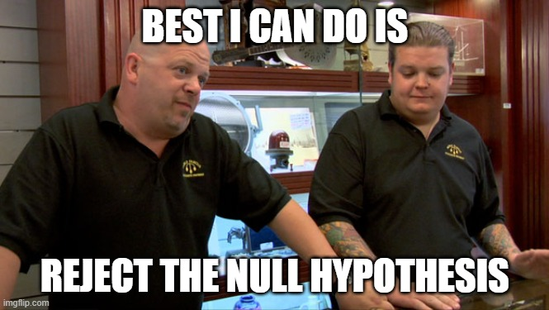

Slide 44
Pro Tip 😉
If you’re not sure which hypothesis should be the skeptical default,
Write down the two hypothesis options
The option with the ‘=’ sign is always the null hypothesis
…why though?
µ_{D} = µ_{L}
µ_{D} ≠ µ_{L}

Slide 45
Pro Tip 😉
If you’re not sure which hypothesis should be the skeptical default,
Write down the two hypothesis options
The option with the ‘=’ sign is always the null hypothesis
…why though?
This option has the = sign. So this has to be the null hypothesis, H₀
H₀: µ_{D} = µ_{L}
H_{a}: µ_{D} ≠ µ_{L}

Slide 46
Pro Tip 😉
If you’re not sure which hypothesis should be the skeptical default,
Write down the two hypothesis options
The option with the ‘=’ sign is always the null hypothesis
…why though?
Because we can never prove two things are equal. But with evidence, we can prove two things are NOT equal (and can reject H₀)
H₀: µ_{D} = µ_{L}
H_{a}: µ_{D} ≠ µ_{L}

Slide 47
Choosing the right statistical tests
Factors | Levels | Within/Between | Parametric Test | Non-parametric Test
1 | 2 | Between | Independent sample t-test | Mann-Whitney U test
1 | 2 | Within | Paired sample t-test | Kruskal-Wallis test
1 | >2 | Between | One-way ANOVA | Wilcoxon Signed-rank test
1 | >2 | Within | One-way Repeated Measures ANOVA | Friedman test
>1 | ≥ 2 | Between | Factorial ANOVA, Linear Model | Aligned Rank Transform (ART)
>1 | ≥ 2 | Within | Factorial Repeated Measures ANOVA, Generalized Linear Model | ART/ Generalized Linear Mixed Model

Slide 48
Choosing the right statistical tests
Factors | Levels | Within/Between | Parametric Test | Non-parametric Test
1 | 2 | Between | Independent sample t-test | Mann-Whitney U test
1 | 2 | Within | Paired sample t-test | Kruskal-Wallis test
1 | >2 | Between | One-way ANOVA | Wilcoxon Signed-rank test
1 | >2 | Within | One-way Repeated Measures ANOVA | Friedman test
>1 | ≥ 2 | Between | Factorial ANOVA, Linear Model | Aligned Rank Transform (ART)
>1 | ≥ 2 | Within | Factorial Repeated Measures ANOVA, Generalized Linear Model | ART/ Generalized Linear Mixed Model
A ‘factor’ is an independent variable that we’re varying across study conditions.

Slide 49
Choosing the right statistical tests
Factors | Levels | Within/Between | Parametric Test | Non-parametric Test
1 | 2 | Between | Independent sample t-test | Mann-Whitney U test
1 | 2 | Within | Paired sample t-test | Kruskal-Wallis test
1 | >2 | Between | One-way ANOVA | Wilcoxon Signed-rank test
1 | >2 | Within | One-way Repeated Measures ANOVA | Friedman test
>1 | ≥ 2 | Between | Factorial ANOVA, Linear Model | Aligned Rank Transform (ART)
>1 | ≥ 2 | Within | Factorial Repeated Measures ANOVA, Generalized Linear Model | ART/ Generalized Linear Mixed Model
A factor can take 2 or more ‘levels’

Slide 50
Factors and Levels
Factor: UI
Levels: Dark and Light
Dependent variable: usage duration
30
20
Usage duration (min)
10
Dark mode
Light mode

Slide 51
Factors and Levels
Factor: UI
Levels: Dark and Light
Dependent variable: usage duration
30
20
Usage duration (min)
What we’re studying
10
Dark mode
Light mode

Slide 52
Factors and Levels
Factor: UI
Levels: Dark and Light
Dependent variable: usage duration
30
20
Usage duration (min)
10
How many bars in the plot
Dark mode
Light mode

Slide 53
Factors and Levels
Factor: UI
Levels: Dark and Light
Dependent variable: usage duration
30
20
Usage duration (min)
10
What we’re measuring
Dark mode
Light mode

Slide 54
Factors and Levels
Factor: Keyboard
Levels: iPhone, Pixel, Huawei
Dependent variable: Typing speed, number of errors
30
20
Typing speed (words/min)
10
iPhone
Pixel
Huawei

Slide 55
Choosing the right statistical tests
Factors | Levels | Within/Between | Parametric Test | Non-parametric Test
1 | 2 | Between | Independent sample t-test | Mann-Whitney U test
1 | 2 | Within | Paired sample t-test | Kruskal-Wallis test
1 | >2 | Between | One-way ANOVA | Wilcoxon Signed-rank test
1 | >2 | Within | One-way Repeated Measures ANOVA | Friedman test
>1 | ≥ 2 | Between | Factorial ANOVA, Linear Model | Aligned Rank Transform (ART)
>1 | ≥ 2 | Within | Factorial Repeated Measures ANOVA, Generalized Linear Model | ART/ Generalized Linear Mixed Model
Between: The conditions have independent participants
Within: The same participant belongs to multiple conditions

Slide 56

King Nebuchadnezzar’s Experiment
Team Daniel
Kosher (Pulse and water)

Slide 57
King Nebuchadnezzar’s Experiment
Team Daniel
Kosher (Pulse and water)
Team Nebuchadnezzar
Non-Kosher (Meat and wine)

Slide 58
King Nebuchadnezzar’s Experiment
10 people in each team. Observe for 10 days. Declare winner by manual observation.
Team Daniel
Kosher (Pulse and water)
Team Nebuchadnezzar
Non-Kosher (Meat and wine)

Slide 59
King Nebuchadnezzar’s Experiment
10 people in each team. Observe for 10 days. Declare winner by manual observation.
Factor: ?
Levels: ?
Within/Between: ?
Team Daniel
Kosher (Pulse and water)
Team Nebuchadnezzar
Non-Kosher (Meat and wine)

Slide 60
King Nebuchadnezzar’s Experiment
10 people in each team. Observe for 10 days. Declare winner by manual observation.
Factor: Food habit
Levels: Two
Within/Between: Between
Team Daniel
Kosher (Pulse and water)
Team Nebuchadnezzar
Non-Kosher (Meat and wine)

Slide 61
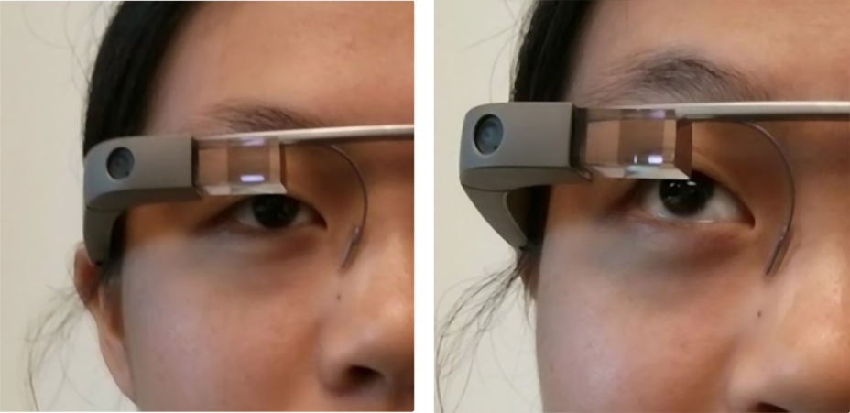

Slide 62
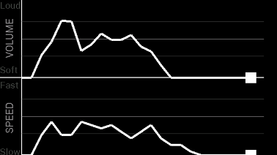
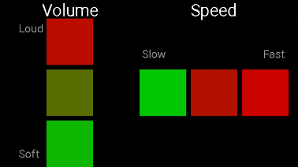
We want to test whether line plot feedback or bar plot feedback is more useful. We have 20 participants. Each participant tries both interfaces.

Slide 63
We want to test whether line plot feedback or bar plot feedback is more useful. We have 20 participants. Each participant tries both interfaces.
Factor: ?
Levels: ?
Within/Between: ?

Slide 64
We want to test whether line plot feedback or bar plot feedback is more useful. We have 20 participants. Each participant tries both interfaces.
Factor: The UI
Levels: Two (line and bar plots)
Within/Between: Within

Slide 65
Choosing the right statistical tests
Factors | Levels | Within/Between | Test name
1 | 2 | Between | Independent sample t-test
1 | 2 | Within | Paired sample t-test
1 | >2 | Between | One-way Anova
1 | >2 | Within | One-way Repeated Measures Anova

Slide 66
Independent Sample t-test
One factor, two levels, between sample.
30
H₀: µ_{D} = µ_{L}
H_{a}: µ_{D} ≠ µ_{L}
20
Usage duration (min)
10
Dark mode
Light mode

Slide 67
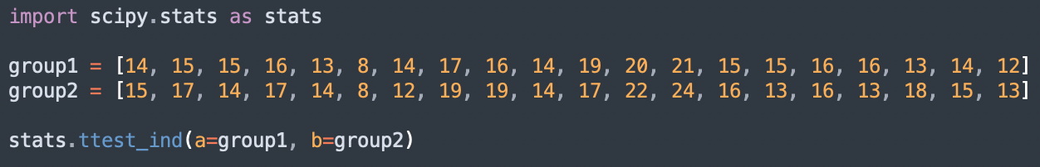
Independent Sample t-test
statistic=-0.63, p=0.53
If p<0.05, reject H₀
Else, “we do not observe a detectable difference between the two groups”

Slide 68
Choosing the right statistical tests
Factors | Levels | Within/Between | Test name
1 | 2 | Between | Independent sample t-test
1 | 2 | Within | Paired sample t-test
1 | >2 | Between | One-way Anova
1 | >2 | Within | One-way Repeated Measures Anova

Slide 69
Paired Sample t-test
One factor, two levels, within subjects. So each participant provides multiple data points.
30
H₀: µ_{pre} = µ_{post}
H_{a}: µ_{pre} ≠ µ_{post}
20
Usage duration (min)
10
Pre
Post

Slide 70
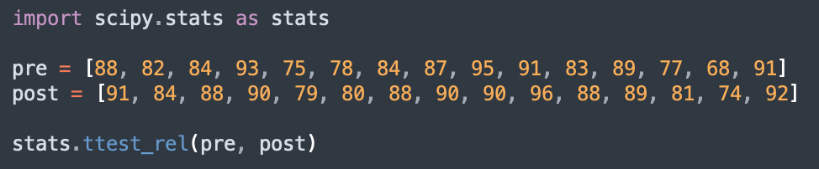
Paired Sample t-test
statistic=-2.97, p=0.01
Here, p<0.05. So we get to reject H₀
There is overwhelming evidence that the two groups are different!

Slide 71
Choosing the right statistical tests
Factors | Levels | Within/Between | Test name
1 | 2 | Between | Independent sample t-test
1 | 2 | Within | Paired sample t-test
1 | >2 | Between | One-way Anova
1 | >2 | Within | One-way Repeated Measures Anova

Slide 72
One-way Anova
30
20
Typing speed (words/min)
H₀:
H_{a}:
10
iPhone
Pixel
Huawei

Slide 73
One-way Anova
30
20
Typing speed (words/min)
H₀: μ₁ = μ₂ = μ₃ = … = μ_{k}
H_{a}: at least one population mean that differs from the rest
10
iPhone
Pixel
Huawei
We have three levels here

Slide 74
One-way Anova
Omnibus test: for levels >2
First, we need to confirm that there is something worth testing. If the omnibus test gives a ‘significant’ p value, we have the permission to conduct pairwise t-tests to find out which pair of conditions are different from each other.
30
20
Typing speed (words/min)
H₀: μ₁ = μ₂ = μ₃ = … = μ_{k}
H_{a}: at least one population mean that differs from the rest
10
iPhone
Pixel
Huawei
We have three levels here

Slide 75
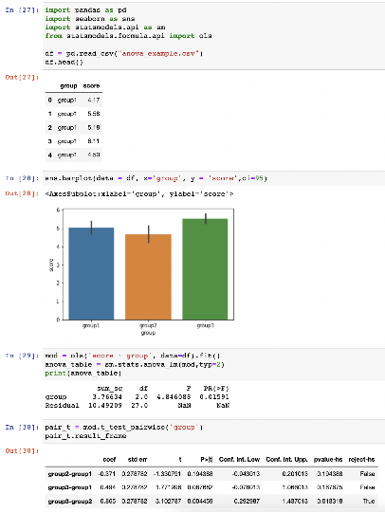

Slide 76
Plotting the data with 95% C.I. as error bars. Visually eyeballing the data, we can expect group2 and group3 to be significantly different as their error bars are non-overlapping

Slide 77
Running the Omnibus test. Here, p=0.015, so we can reject H₀. In other words, there is overwhelming evidence that at least one group is different than the others. We have permission to conduct pairwise tests.

Slide 78
Omnibus test reporting format:
F (2,27) = 4.85, p = 0.016

Slide 79
Here, we conduct the pairwise t-tests to see which two groups are actually different. The code makes corrections for multiple comparisons using Holm’s Sequential Bonferroni Procedure, so we don’t need to worry about anything. The results show that group2 and group3 have a significant difference as their t-test gives a corrected p=0.013318, which is <0.05. The other pairwise comparisons show no measurable difference.

Slide 80
Choosing the right statistical tests
Factors | Levels | Within/Between | Test name
1 | 2 | Between | Independent sample t-test
1 | 2 | Within | Paired sample t-test
1 | >2 | Between | One-way Anova
1 | >2 | Within | One-way Repeated Measures Anova

Slide 81
One-way Repeated Measures Anova
Omnibus test
>2 levels, so we need the omnibus test first. Also, since it is within subjects design, each participant gives multiple data points.
30
H₀: μ₁ = μ₂ = μ₃ = … = μ_{k}
H_{a}: at least one population mean that differs from the rest
20
Typing speed (words/min)
10
iPhone
Pixel
Huawei

Slide 82
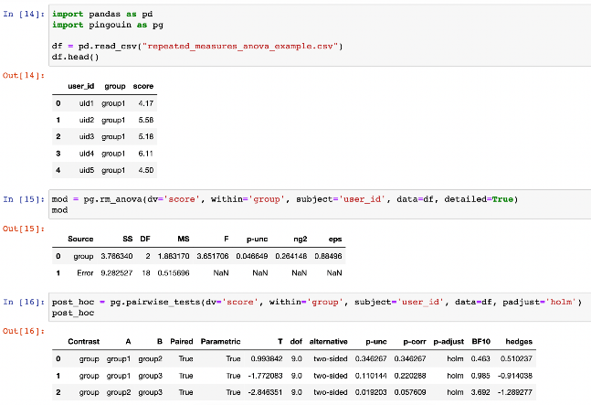
This one explicitly tells in each row which data point is from which user.

Slide 83
The omnibus test gives p = 0.0466, which is <0.05. We have permission to conduct pairwise tests.

Slide 84
The pairwise tests show that only group2 and group3 are significantly different (with p=0.019203).

Slide 85
References
Designing, running, and analyzing experiments, by Dr. Jacob O. Wobbrock
Data Mining: Concepts and Techniques, by Jiawei Han, Micheline Kamber, and Jian Pei

Slide 86
Summary

